Slide 1
2019 Sensory-Friendly Performance sponsored by Astra Foundation

Slide 2
Going to see
Seeing a theater show is a little like seeing something on TV, or a movie; but the people in a show are right there on the stage. They are called actors.

Slide 3
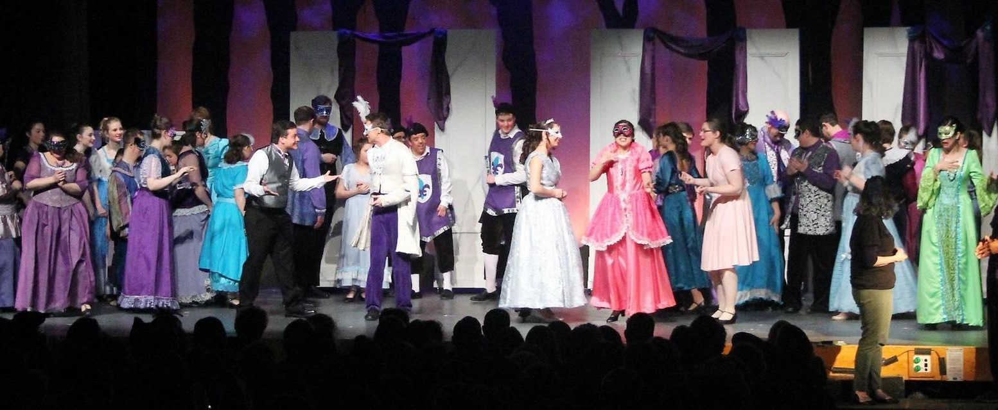
The Little Mermaid is a special kind of show called a musical. The actors tell a story by talking, singing, and dancing.

Slide 4
Where am I going?
The performance is at Raymond J. Grey Junior High School in Acton, Massachusetts. The address is 16 Charter Road, Acton, Massachusetts 01720.

Slide 5
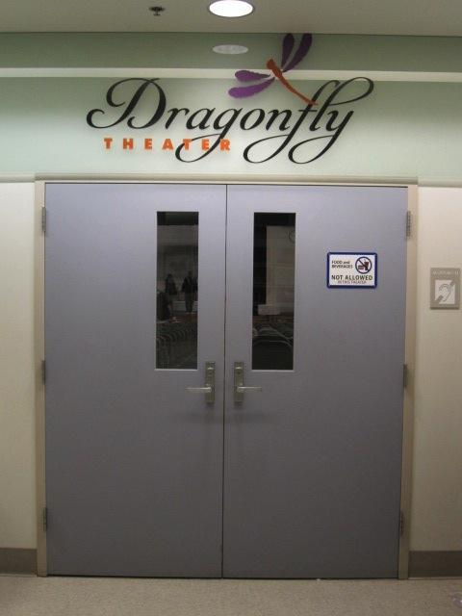
The Dragonfly Theater
The Dragonfly Theater is inside the Raymond J. Grey Junior High school. I will see the show The Little Mermaid in the Dragonfly Theater.
Another word for a theater is an “auditorium.”

Slide 6
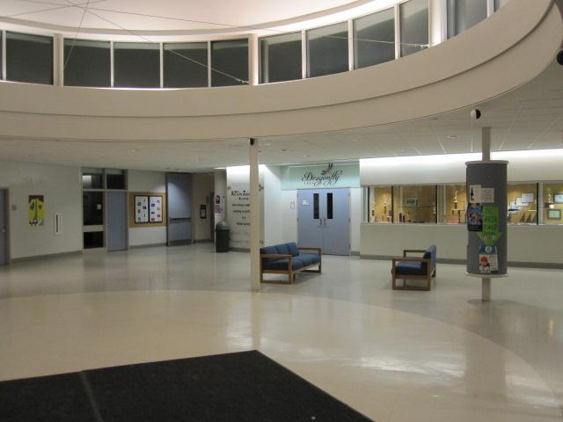
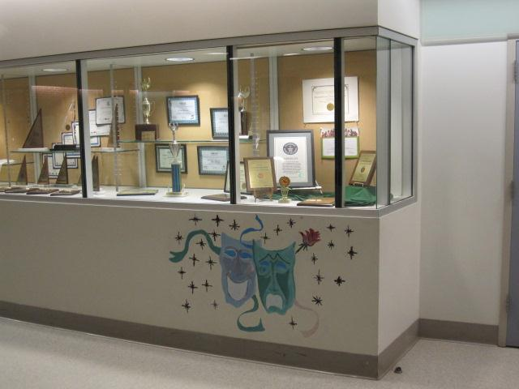
Waiting
We may have to stand in line to get into the theater. I will do my best to be patient while we wait. We will show our tickets to a person called an “usher” who will tell us where to go.

Slide 7
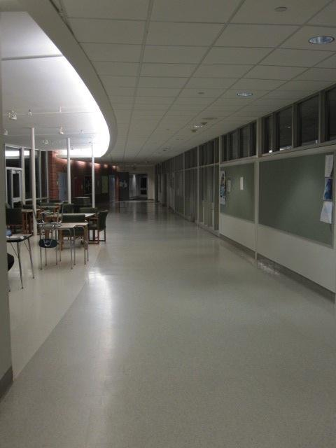
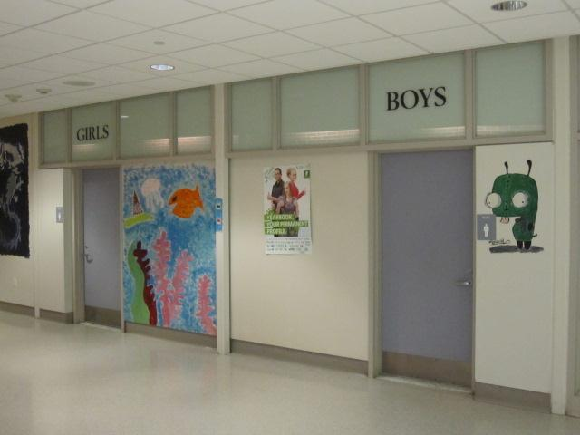
Bathroom Break
When we enter the school, the bathrooms are located down the hallway to the right of The Dragonfly Theater. I can ask if I need to go to the bathroom. Family bathrooms are here if I need someone to come with me.
Before the show and intermission are good times to use the bathroom. I can also take a break during the show if I need to.

Slide 8
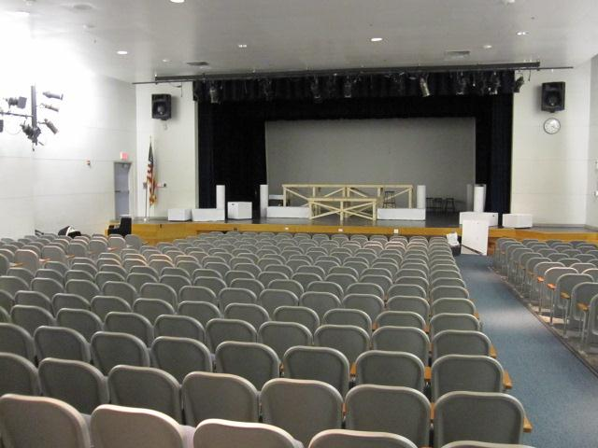
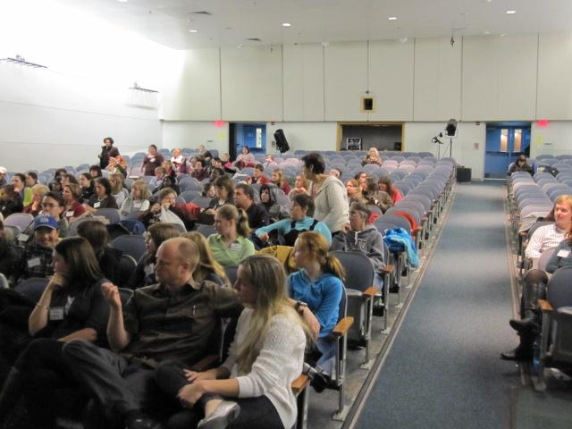
Inside the Theater
There are 450 seats in the theater. An usher will help us find our seats. The ticket will tell us what number seat to find.

Slide 9
Program
The usher will also give us a “Program.” The program is a small book that tells you about the people who helped make the show. Programs list the names of the actors and the titles of the songs in the show.
A program is also called a “Play Bill.”

Slide 10
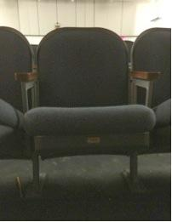
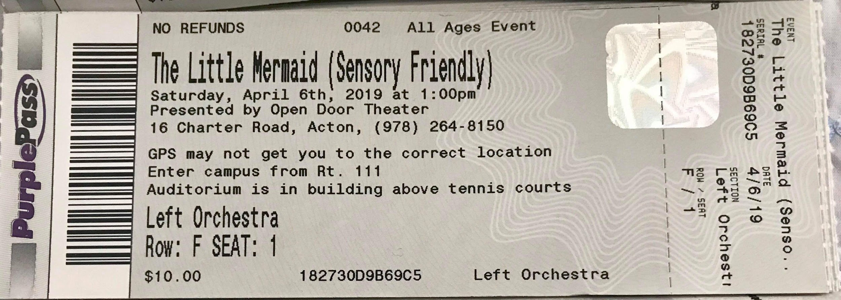
Sitting Down
I will find my seat by matching the ticket number to the seat. When we get to our seats, I will fold down my theater chair and sit down.

Slide 11
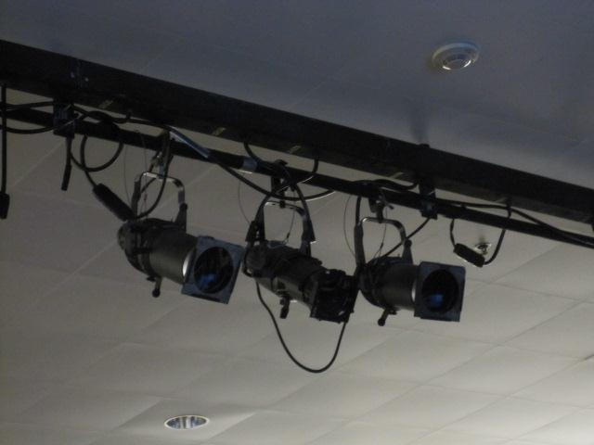
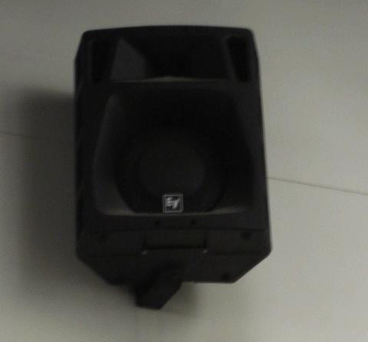
The Auditorium
I can look all around the theater before the show starts. Many different things inside the auditorium might be new to me.
I might see stage lights, speakers, and musical instruments. Quiet music might be playing in the auditorium.

Slide 12
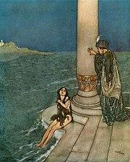
The Little Mermaid Story
Hans Christian Anderson first wrote The Little Mermaid in 1837. Since then, many other people have told the story in different ways.
This show is based on the Disney movie version of The Little Mermaid, so most of the characters and songs are the same. I will also hear new songs. Some parts of the story in the show are different from the movie, especially in the second act.

Slide 13
Introducing Actors
Before the Sensory Friendly show, some of the actors will come out on the stage to introduce themselves. The actors will tell me about themselves and how they pretend to play a part, or act, in the show.

Slide 14
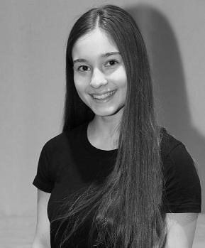
Ariel, the Little Mermaid
Casey plays the title character of The Little Mermaid, named Ariel. Ariel is very inquisitive and curious, so she wants to learn more about the human world.
Ariel is growing up and wants to be treated like an adult. She falls in love with Prince Eric and wants to find a way to stay with him.
In real life, Casey is a junior at Lincoln-Sudbury Regional High School. Casey loves singing, dancing, and performing in lots of plays.

Slide 15
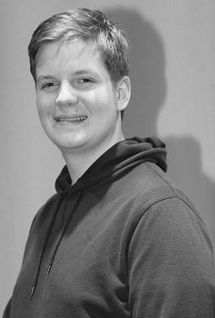
Prince Eric
.
Drew plays Prince Eric. Eric is getting ready to be king. He is learning about the world in order to be a good king.
Eric hears Ariel singing when she rescues him from drowning, but he doesn’t know who she is. Eric is determined to find the girl whose voice he heard.
In real life, Drew is a junior in high school attending Mass Bay Community College. Drew is also an actor on the autism spectrum.

Slide 16
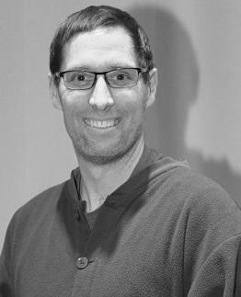
King Triton
King Triton is Ariel’s father. He rules the underwater kingdom. He loves his daughter and wants to protect her. Sometimes he gets very angry because he thinks Ariel’s actions and interest in humans put her in danger.
Brian plays King Triton. He will yell and shout when he pretends to be very angry with Ariel. In real life, Brian is a loving dad with 3 kids.

Slide 17
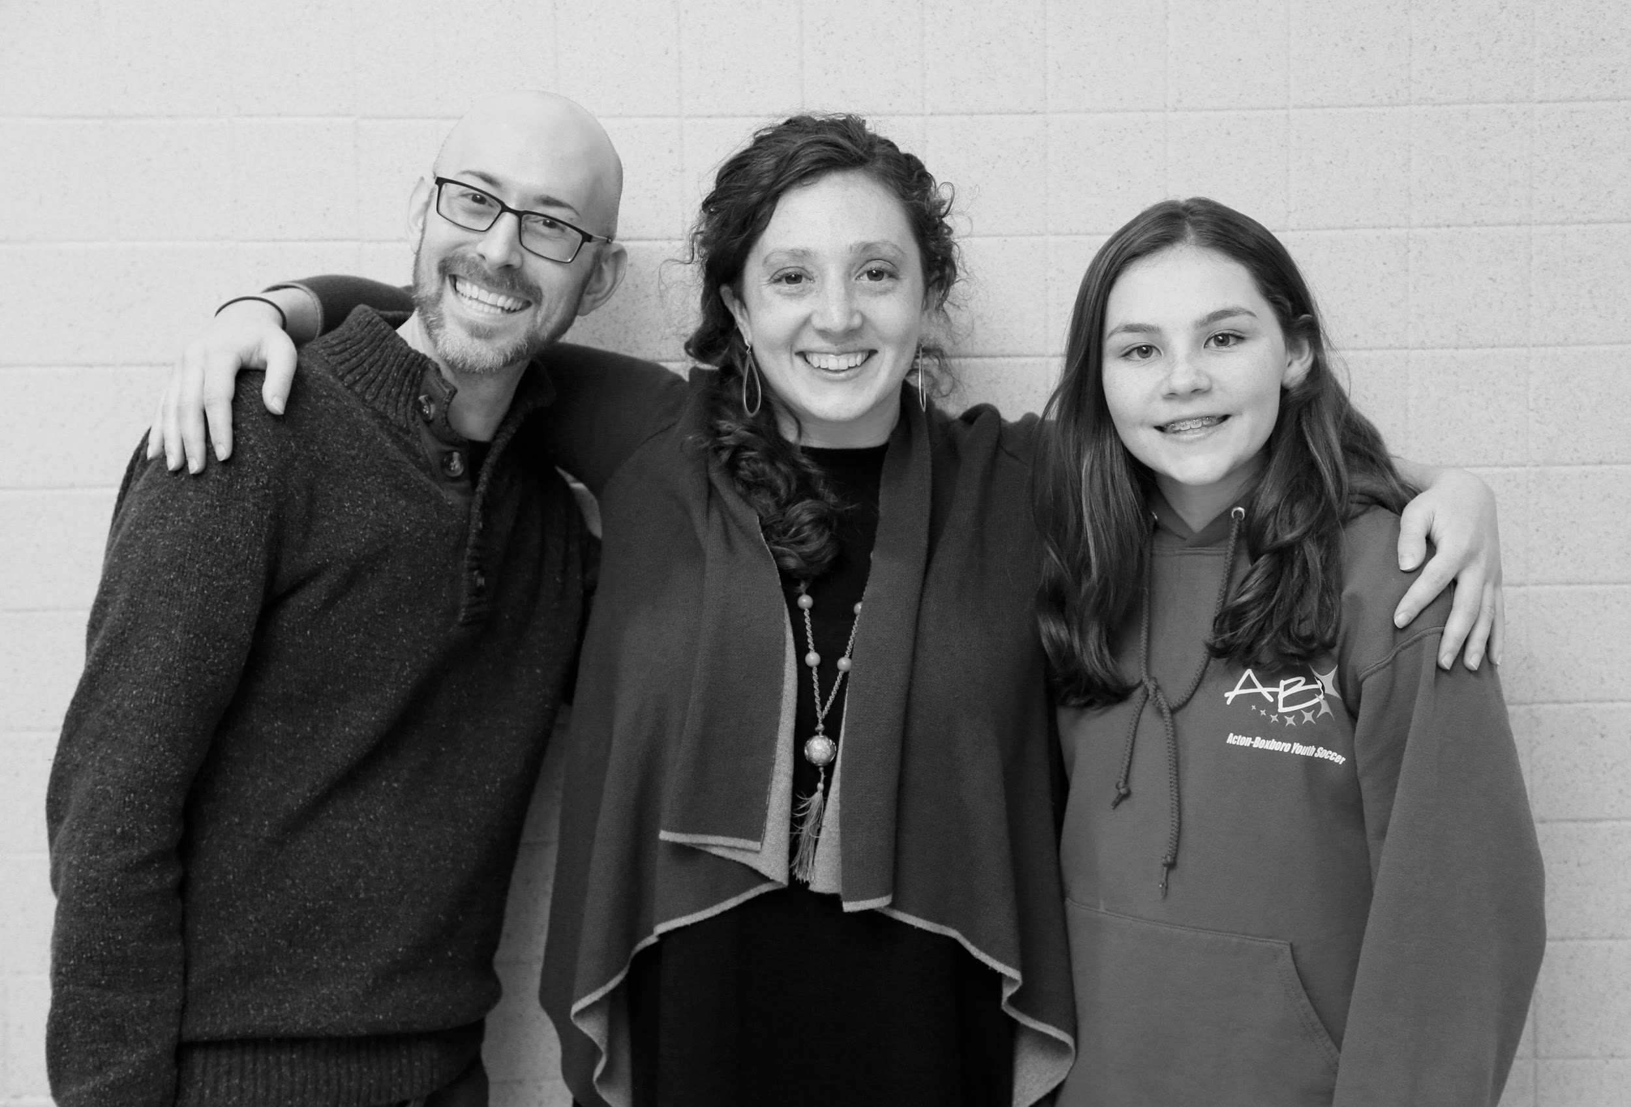
Ursula, Flotsam, and Jetsam
Maddie plays Ursula, the Sea Witch. Ursula has powerful magic and wants to take over her brother Triton’s kingdom. She was banished for using black magic, so she wants revenge.
Josh and Adriana play Flotsam and Jetsam. They are Ursula’s sneaky helpers.
Maddie, Josh, and Adriana will act mean and cruel, but that is just pretend. In real life, Maddie is a kind person who works helping the elderly.

Slide 18
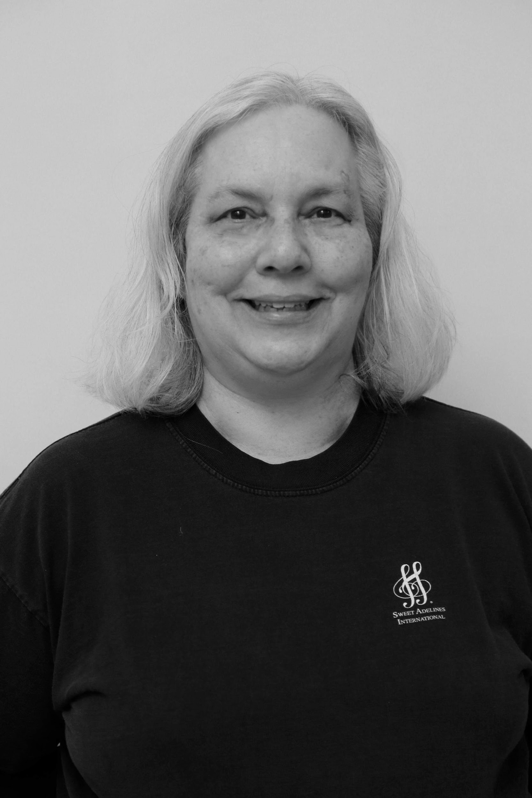
Chef Louis
Terri plays Chef Louis. Chef Louis works at the palace, cooking great food. He bosses around lots of other chefs to get the food just right. Chef Louis almost cooks Sebastian for dinner because he doesn’t know Sebastian is Ariel’s friend. Ariel helps her friend get away.
In real life, Terri is a physical therapist who also makes the costumes for Open Door Theater.

Slide 19
Starting the Show
When it is time for the show to start, the theater will get darker and everyone will get quiet. I will try to be as quiet as I can during the show so that I can hear everything and everyone else can hear too.
The Little Mermaid will run about 2 hours, including a 20 minute intermission in the middle.

Slide 20
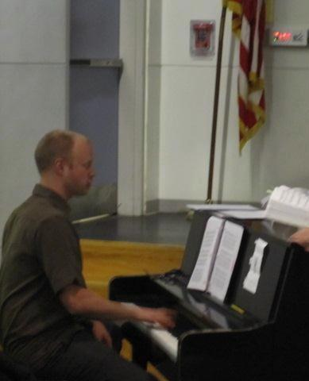
When the show starts, I will hear music from the orchestra. The first song the orchestra plays is called the Overture. The overture is a instrumental preview of the songs in the show.
Then the lights come on the stage and the curtain opens. The actors will start to talk, dance, and sing to tell the story of The Little Mermaid .

Slide 21
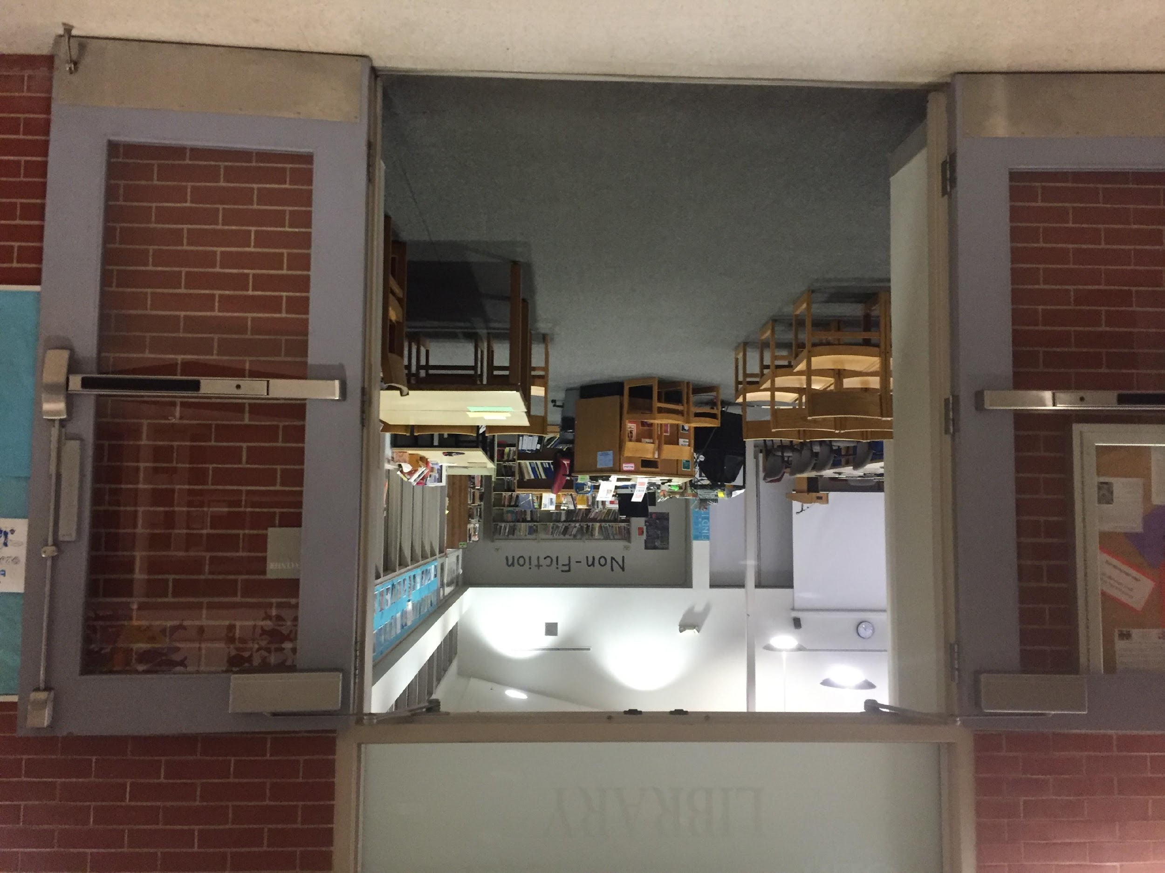
Chill-Out Room
If I feel like I need to move out of my seat, I can quietly ask if I can take a break. Then, I will exit the theater into the lobby and go to the Chill-Out Room to take a break. The Chill-Out room is in the library. I can stay here until I feel ready to go back inside the theater.
In the Chill-Out Room, I can watch The Little Mermaid on a TV screen so I know what is happening.

Slide 22
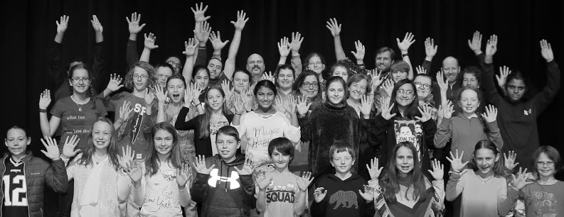
Clapping
After each song, some people will clap. Clapping tells the actors that you liked their performance.
You may see actors onstage and people in the audience using the American Sign Language sign for “clapping.” They shake both hands in the air so Deaf actors can see their appreciation.

Slide 23
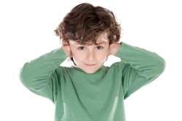
Noise
The play and the cheering audience can be very loud. If the sounds are too loud, I can cover my ears, wear my headphones, or squeeze the Open Door Theater toy that I was given before the show. I will do my best to stay in my seat and be quiet when it is not time to cheer.

Slide 24
Intermission
In the middle of the show, there will be a break. This break is called Intermission. During the break, many people will stand up to stretch, get a drink, or use the bathroom.

Slide 25
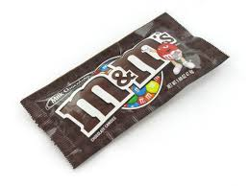
Snacks
During Intermission at the Sensory Friendly Show, The Open Door Theater will be giving out snacks! They will have plain Lay’s potato chips, plain M&M’s and water bottles. I will be allowed to bring my snack into the theater.

Slide 26
Back to the Show
After the break, everyone will come back and sit down in their seats again. It will get darker and quieter again, just like at the beginning of the show. The actors will come back on the stage and finish telling the story The Little Mermaid.

Slide 27
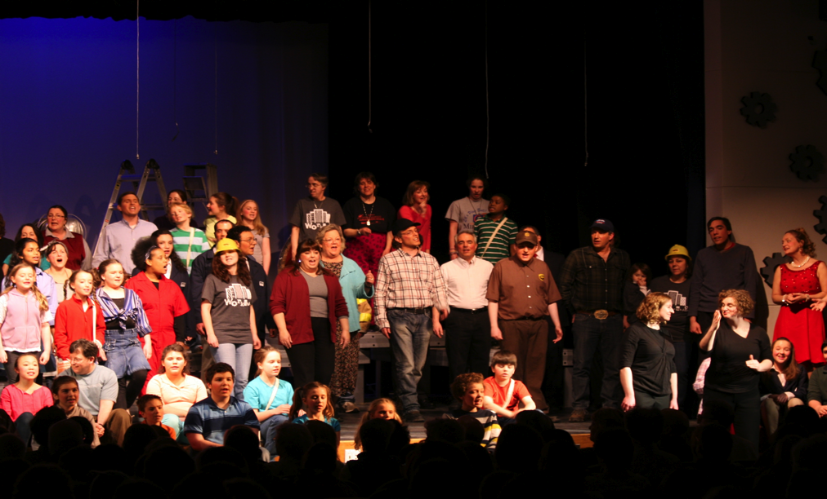
Curtain Call
At the end of the play, all of the actors come out on stage to take a bow. This is called a curtain call. Many people clap and cheer so the actors know how much they liked the show.
I can clap or cheer if I want to. If it is too loud, I can cover my ears.

Slide 28
Exiting the Theater
After the show is over, the lights will come on and we will exit the theater. Some of the actors will be in their The Little Mermaid costumes in the lobby. If I want to, I can wave hello, shake their hand, or get their autograph in my Program.
I am excited to go see The Little Mermaid!
Written by Emily Harvey Lacroix, Adapted from Social Stories by Lauren Cantos Smith and The Autism Alliance of MetroWest, a Program of Advocates, Inc.

